Slide 1
Autonomous Vehicle Lane Detector
Adam Goldstein

Slide 2
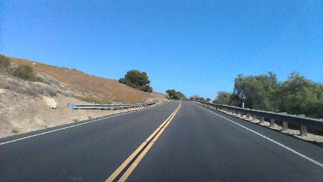
Data Collection
Utilized 12,000 recorded driving images
Each image had a corresponding text file containing polynomials used for labeled lane markings
These polynomial text files were converted to labeled lane images to be trained to

Slide 3
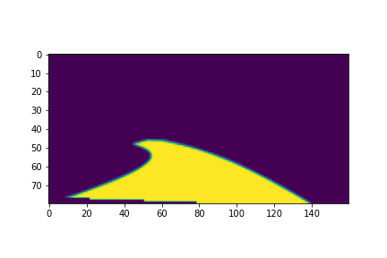
Image Processing
Road images standardized to pixel size of (80,160,3)
RGB color values normalized from (0-255) to (0-1) range for Keras interpretability
Labeled dataset contains solely the ‘G’ channel from an RGB image

Slide 4
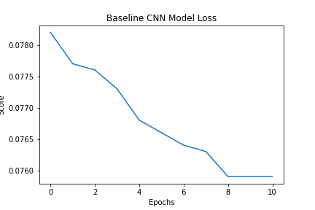
Training: Baseline Model
Baseline neural network contained one inner layer
Model was evaluated using mean squared error
Loss showed convergence around 10 epochs

Slide 5
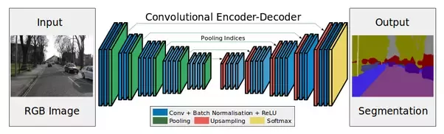
Training: Fully Connected CNN
Final model used was fully connected CNN
Model contained 13 deep layers
Implemented encoder-decoder architecture as it is known to perform well for pixel segmentation
Model outputs pixel array to be evaluated against ground truth pixel array with regression

Slide 6
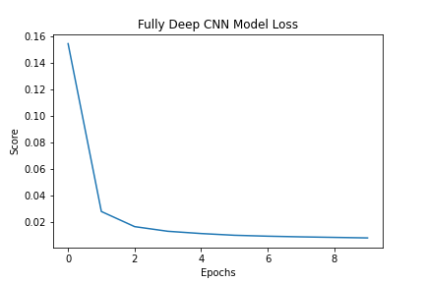
Results
Final model converged to a mean squared error loss value of 0.0059
Optimal hyperparameters selection
Batch Size: 128
Epochs: 10
Dropout: 0.2

Slide 7
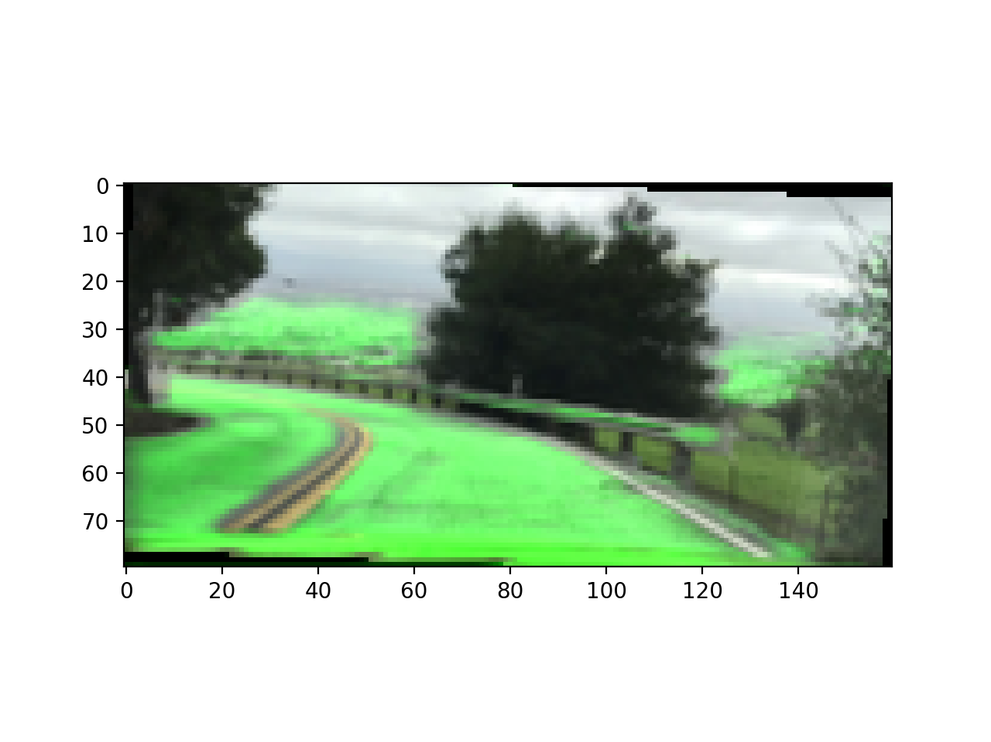
Results
Baseline model tended to categorize any flat surface in image as lane segment

Slide 8
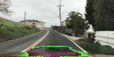
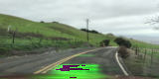
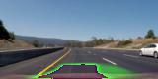
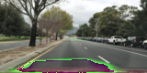
Results
Final model successfully deciphered roadway from non-roadway
Model struggled to maintain lane prediction toward image horizon
Model struggled with shadowy conditions

Slide 9
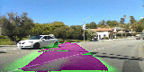
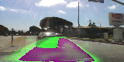
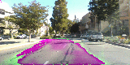
Results

Slide 10
Next Steps
Implement Autoencoder (VGG16)
Combined Lane Detection with Vehicle Detection using Yolo V5
Display prediction confidence as well as radius of curvature
Further implementation of lane prediction Flask app

Slide 11
Questions?

Slide 12
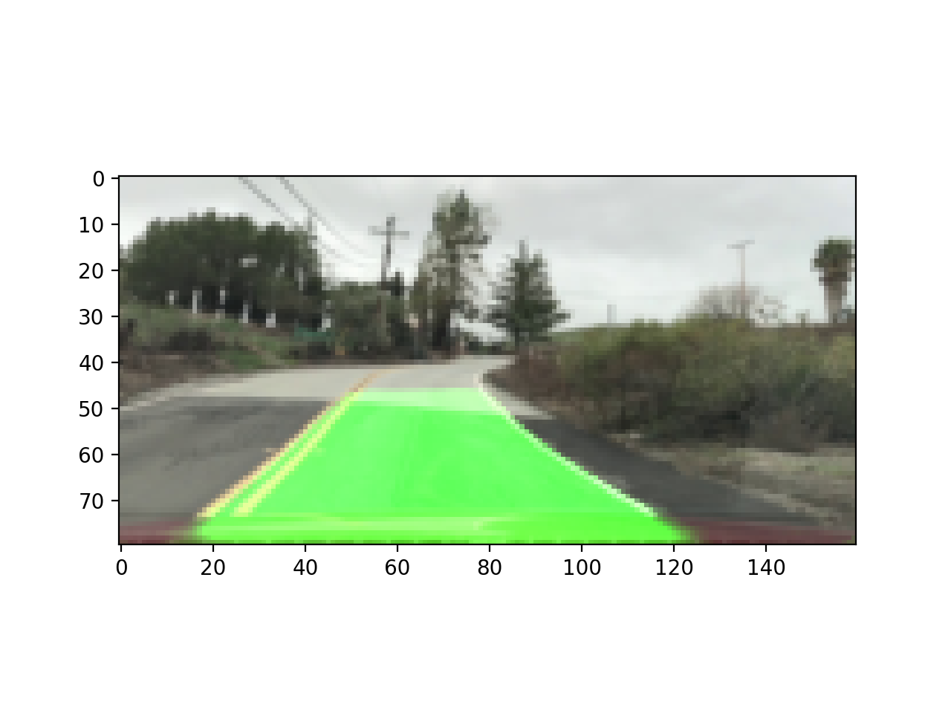
Appendix

Slide 13
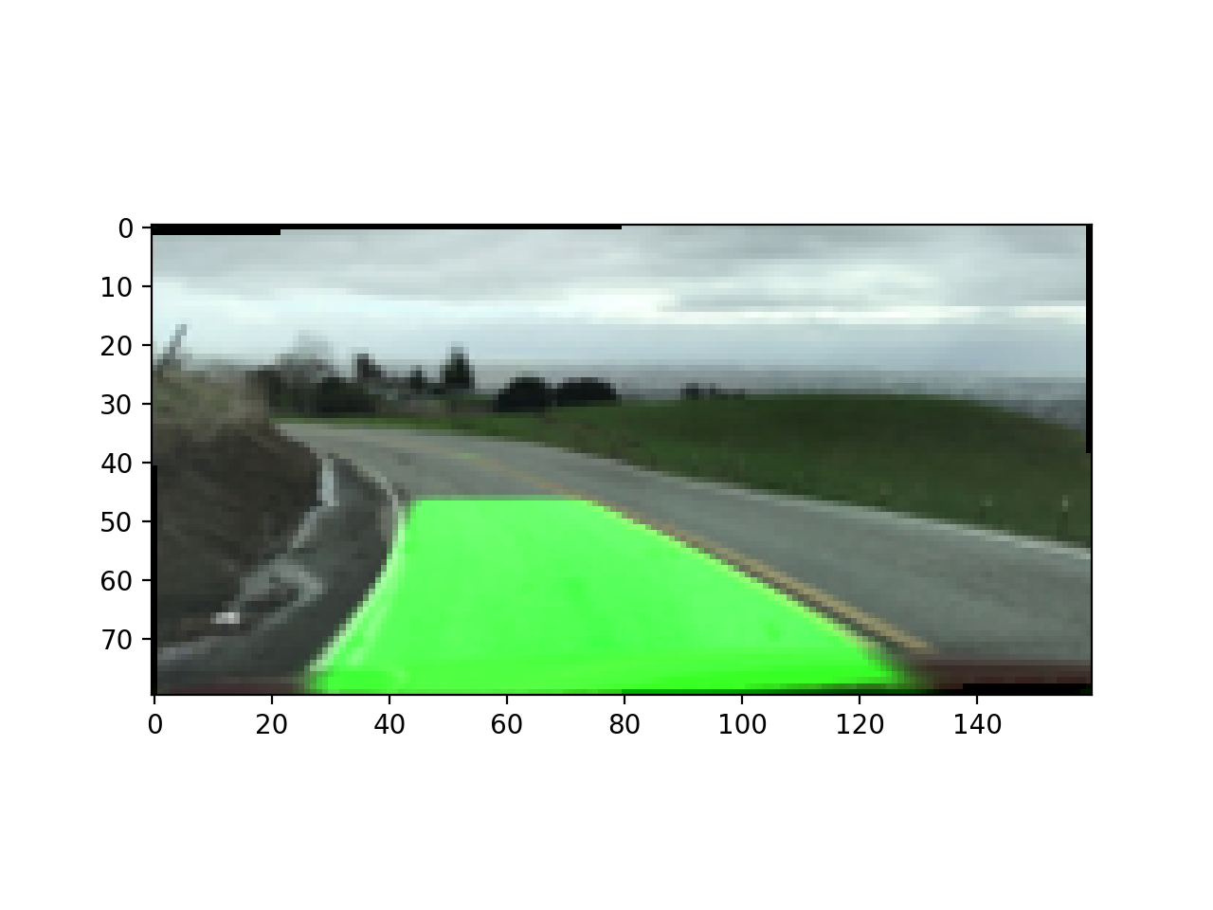
Appendix

Slide 14
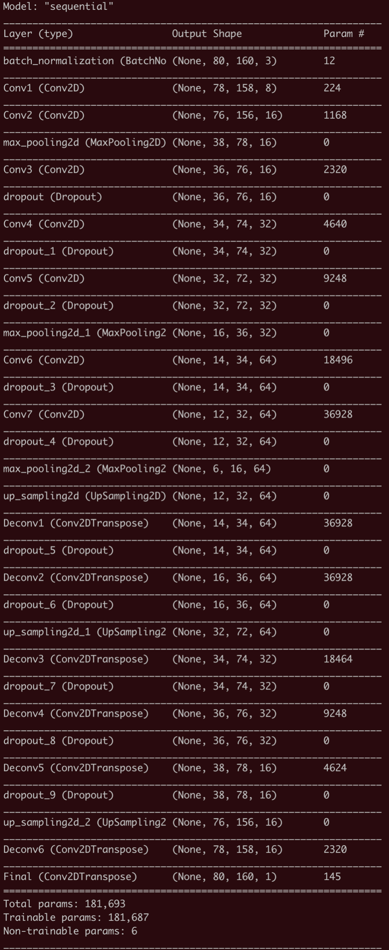
Appendix

